Slide 1
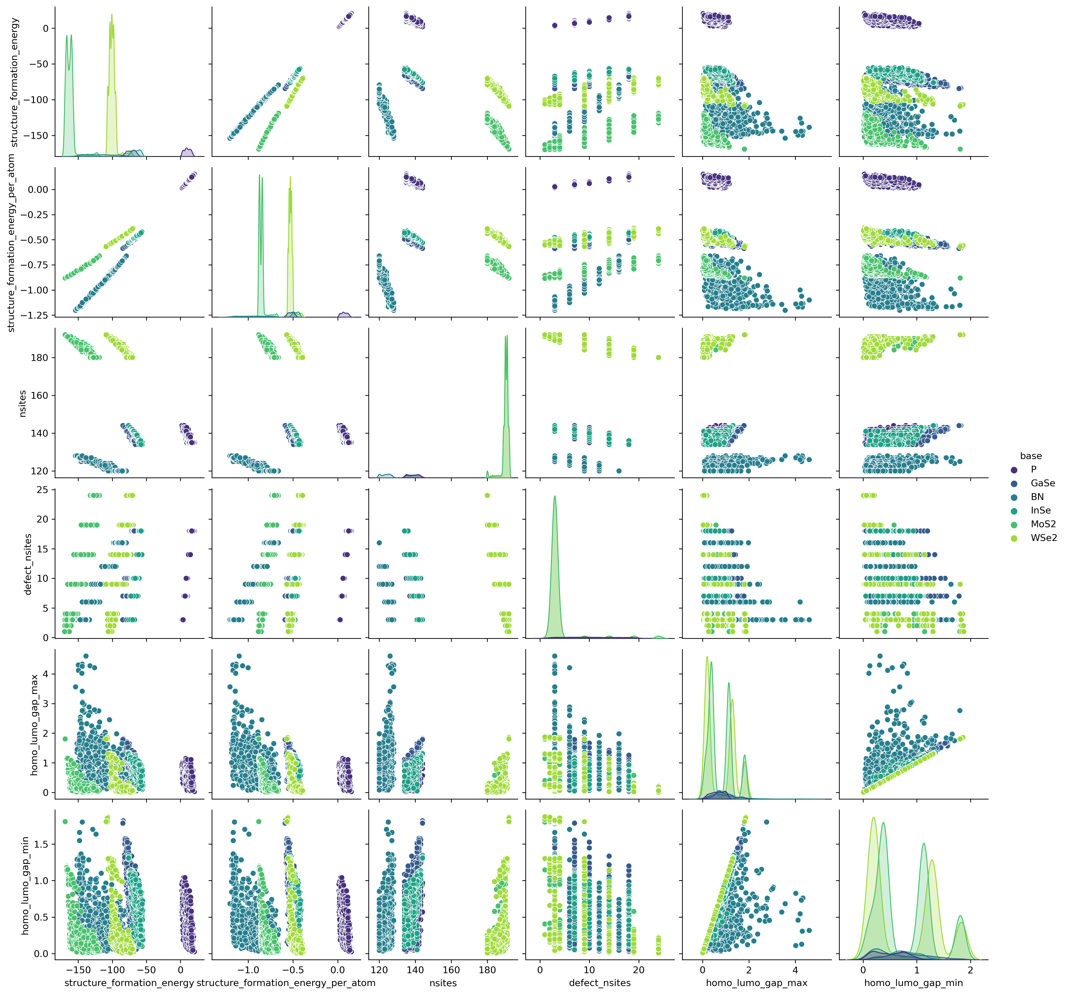
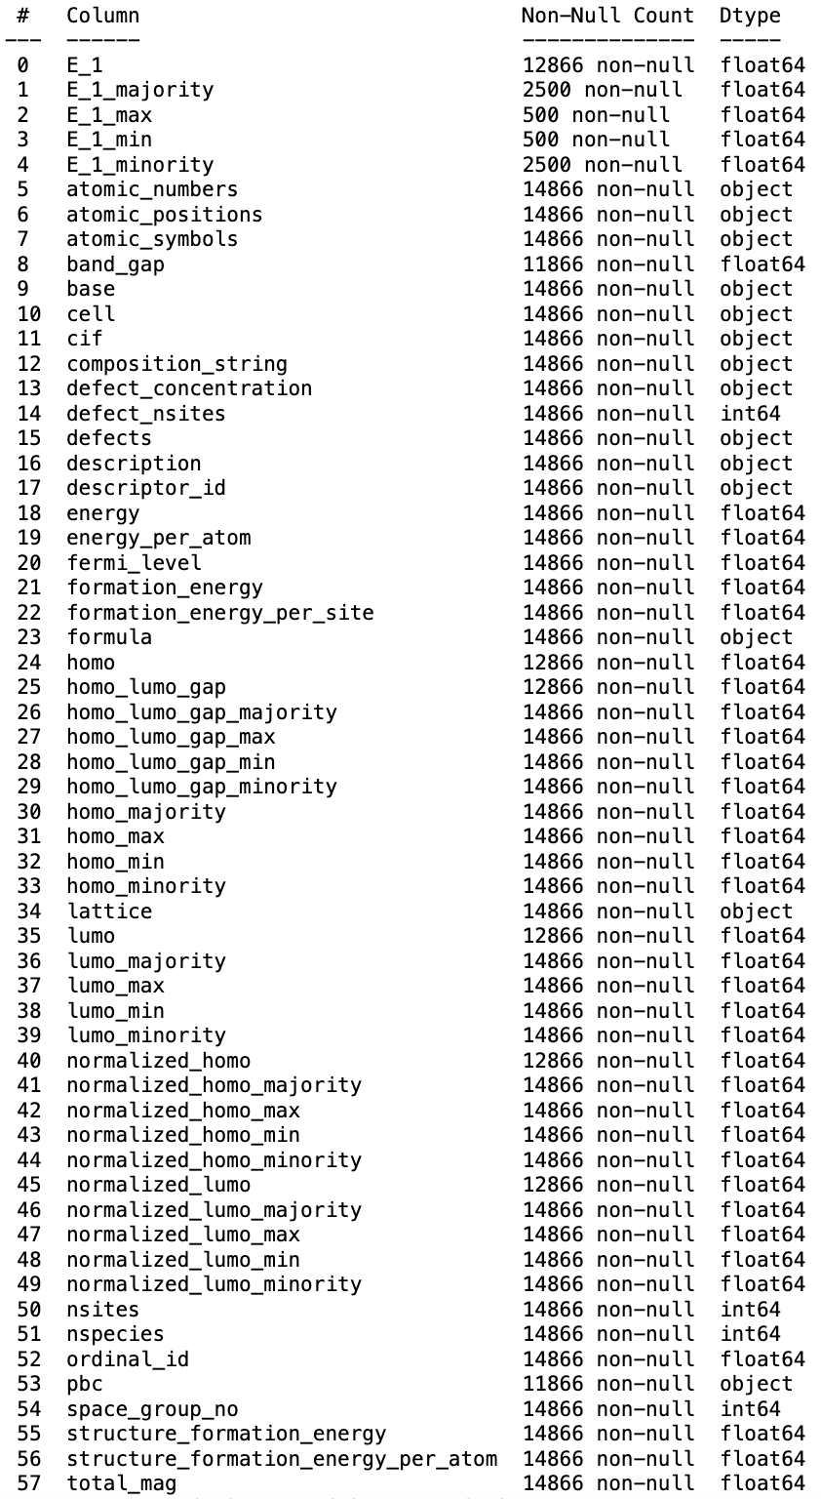
2DMD datasets DS playground
Original 2DMD Datasets
npj 2D Materials and Applications (2023)7:6
2DMD at a Glance merging available data
+ additional data
2DMD Datasets as a Pandas dataframe on user’s workstation

